Slide 1
To Do Workshop

Slide 2
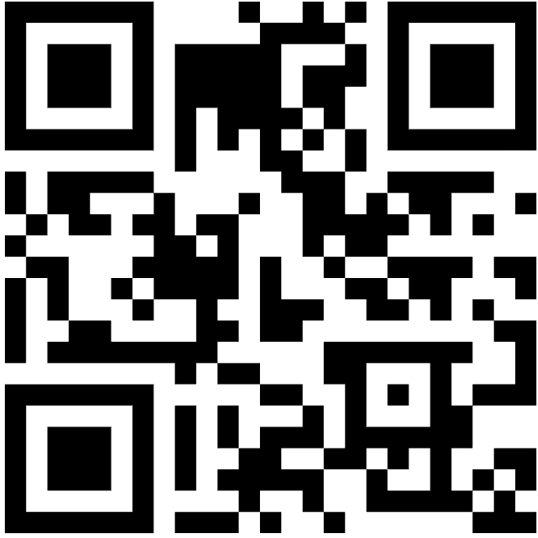
Repo
https://github.com/mikivujkovic/claude-code-ddd-tdd-bdd

Slide 3
npx create-next-app@latest .

Slide 4
Add a ToDo
Title must be present (not empty)
Title is trimmed and normalized
Optionally: maximum title length
Optionally: duplicates allowed or not (decide in DDD)

Slide 5
Add a ToDo
DDD artifacts (language + invariants + contract)
TDD domain implementation (tests drive behavior)
BDD scenario and mapping (behavior examples)

Slide 6
Setup
Hook: enforce-phase will block UI edits
If phase is ddd or tdd, changes under app/ will be blocked.
This is expected: “Add todo” starts in domain docs, then domain tests, not UI.
Hook: stop-gate will block stopping in TDD/BDD until you run /verify
So plan to run /verify at the end of TDD and again after BDD edits.

Slide 7
Step 0.1 — Confirm your phase
Run:
/phase
What you’re looking for:
Current phase in docs/workflow/phase.json
DDD/TDD/BDD Definition of Done checklist
Next tasks list

Slide 8
Step 0.2 — Put yourself in DDD phase (if not already)
Run:
/set-phase ddd
/phase
Why: “Add todo” starts as a domain conversation, not a coding task.

Slide 9
Step 1.1 — Activate the DDD mindset (skill)
You don’t “run” skills explicitly; you trigger them by how you ask.
Use DDD language and ask for:
glossary alignment
invariants
use-case contract
minimal model

Slide 10
Prompt:
We are in DDD phase. Use the ddd-playbook style.
Our next capability is “Add todo item”.
Please:
1) Ensure the glossary terms are clear for juniors.
2) Propose 3–5 invariants for Add.
3) Propose a minimal use-case contract (inputs, preconditions, rules, outputs).
No code and no UI language.

Slide 11
Step 1.2 — Use ddd-facilitator to improve language (subagent)
Use the subagent ddd-facilitator.
Review docs/domain/glossary.md and suggest edits so a non-technical stakeholder understands:
- Todo item
- Title
- Todo list
Then propose 3–5 invariants specifically for “Add todo item”.
Keep it minimal.

Slide 12
What you do next:
Accept the edits it suggests (Claude will propose changes with file references)
Why: If devs don’t share language, they write inconsistent code and tests.

Slide 13
Step 1.3 — Generate DDD artifacts using the repo command
Run:
/ddd:story Add todo item
What this command should produce/modify:
docs/domain/model.md (minimal model changes)
docs/domain/invariants.md (2–5 invariants)
A “Use case contract” section in model.md
Why: this command forces a structured output that later drives tests and scenarios.

Slide 14
Step 1.4 — Use domain-modeler to keep the design small
Prompt:
Use the subagent domain-modeler.
Based on docs/domain/model.md and docs/domain/invariants.md, propose:
- the minimal aggregate structure needed for “Add todo item”
- where each invariant should be enforced (inside which domain object)
Keep it junior-friendly and avoid over-engineering.

Slide 15
You’re checking for:
One aggregate root (often a TodoList)
TodoItem as entity inside it
Title as a value object only if it truly reduces bugs
Why: devs tend to put rules in controllers/services; this prevents that.

Slide 16
Step 1.5 — Quick DDD sanity check (risk-checker)
Prompt:
Use the subagent risk-checker.
Look at docs/domain/invariants.md and find:
- ambiguities,
- missing edge cases for “Add todo item”,
- and 3 suggested tests we will likely need later (no code).

Slide 17
Step 1.6 — DDD done criteria for this feature
You’re ready to move to TDD when:
Glossary has clear “Title”, “Todo item”, “Todo list”
Invariants are testable (not vague)
Use case contract exists

Slide 18
Finish phase 1 (ddd phase)
Run: /ddd:model-review (optional but useful)
Run: /retro

Slide 19
Step 2.1 — Switch phase to TDD
Run:
/set-phase tdd
/phase
Hooks now enforce:
UI edits blocked
Stop is gated by /verify

Slide 20
Step 2.2 — Ask tdd-coach for the first smallest test (critical)
Prompt:
Use the subagent tdd-coach.
We are implementing “Add todo item”.
Pick the smallest invariant to test first from docs/domain/invariants.md.
Explain:
- what the RED test should assert,
- why it should fail initially,
- what minimal GREEN implementation should do,
- what REFACTOR to do after.
No UI tests.

Slide 21
Expected output:
A single invariant selected (e.g., “Title cannot be empty”)
A plan for red/green/refactor
Why: the first test sets the “testing style” for the team.

Slide 22
Step 2.3 — RED: write one failing test using the command
Run:
/tdd:red Add todo item
This should result in:
Exactly one failing test
Clear failure reason

Slide 23
If you hit confusion (test framework not set, file locations unknown):
Use test-runner (prompt):
Use the subagent test-runner.
Figure out what test command exists (npm scripts if present).
If missing, suggest a minimal testing setup plan (no implementation code), then return to the RED step.

Slide 24
Step 2.4 — Run /verify after RED? (optional but helpful)
In strict TDD you can run tests directly; but this repo’s discipline prefers /verify.
So do:
/verify (it will fail at this stage; that’s OK)
This verifies that:
the failing test is real
the pipeline is working

Slide 25
Step 2.5 — GREEN: minimal implementation
Run:
/tdd:green
Rules:
Make the smallest change to pass the failing test
Do not implement future invariants yet
Keep logic in domain layer (not UI)

Slide 26
If you’re unsure where logic belongs
Ask domain-modeler (prompt):
Use the subagent domain-modeler.
For the current failing test, tell us the best place to enforce the invariant:
- which domain object should own it
- and why
Keep it minimal.

Slide 27
Step 2.6 — Verify after GREEN
Run:
/verify
You want:
✅ VERIFY PASSED

Slide 28
If failing:
Use test-runner (prompt):
Use the subagent test-runner.
Run the smallest relevant tests, explain the failure, and propose the minimal fix.
After fixing, re-run /verify.

Slide 29
Step 2.7 — REFACTOR
Run:
/tdd:refactor
Refactor targets (typical for “Add todo”):
Rename variables/methods to glossary terms
Extract Title normalization if needed
Ensure aggregate owns invariant enforcement
After refactor:
/verify again
This is non-negotiable in the workflow.

Slide 30
Step 2.8 — Repeat the TDD cycle for the next invariant(s)
Use:
/tdd:next to pick the next smallest test
Then loop:
/tdd:red Add todo item
/tdd:green
/tdd:refactor
/verify

Slide 31
Typical “Add todo” progression of invariants:
Title not empty
Title trimmed
Title max length
Decide on duplicate titles (allowed or not)
Keep each test tiny.

Slide 32
Consolidate learning
Run:
/retro

Slide 33
Step 3.1 — Switch to BDD phase
Run:
/set-phase bdd
/phase
Remember: Stop is still gated by /verify.

Slide 34
Step 3.2 — Ask bdd-writer for scenarios (intent-based, not UI)
Prompt:
Use the subagent bdd-writer.
Write 2–4 scenarios for “Add todo item” in docs/bdd/features/todo.feature.
Constraints:
- Use glossary language (Title, Todo item, Todo list)
- No UI mechanics (no click/type/wait)
- Outcomes must be observable
Include at least one edge case scenario.

Slide 35
Step 3.3 — Generate/update feature file via command
Run:
/bdd:feature Add todo item
You should now have:
A “Feature” section describing value
Scenarios like:
  Add valid todo
  Reject empty title
  Normalize title spacing

Slide 36
Step 3.4 — Map scenarios to application/service calls
Run:
/bdd:map
This updates:
docs/bdd/mapping.md
What you look for:
“Step intent” mapped to application service calls, not UI actions
Domain objects involved (TodoList, TodoItem, Title, etc.)

Slide 37
If mapping degenerates into UI, correct it with bdd-writer
Prompt:
Use the subagent bdd-writer.
Review docs/bdd/mapping.md. Rewrite any mapping that references UI mechanics into intent/service-level mapping.

Slide 38
Step 3.5 — Optional: run BDD automation
Run:
/bdd:run
If test:bdd is not configured, it will give a checklist.
That’s fine—BDD value still exists as documentation + aligned behavior.

Slide 39
Step 3.6 — Final verify (mandatory)
Run:
/verify
You must see:
✅ VERIFY PASSED

Slide 40
Step 4.1 — Log the learning
Run:
/retro
In the learning log, make sure it includes:
What we built: “Add todo” domain behavior + tests + scenarios
One mistake: e.g. “wrote a test too big first”
Concept learned: “invariants drive tests”
Rule of thumb: “one invariant per test”

